Slide 1
Image Captioning via Vision and Language Transformers
Luke Davidson - davidson.lu@northeastern.edu
Kishore Pagidi - pagidi.k@northeastern.edu
Nand Dave - nand.da@northeastern.edu
April 20, 2023

Slide 2
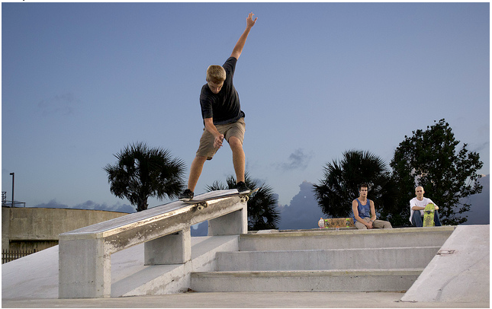

Motivation
What is Image Captioning?
The combination of computer vision and natural language processing techniques to automatically generate accurate captions of unobserved input images
Use Cases
Marketing and media
Automated captioning of social media posts or campaigns
Production
Recommendation systems for image and video editing
Assistance Services
Aiding visually impaired individuals in describing a live view or still image of something
Davidson, Pagidi, Dave

Slide 3
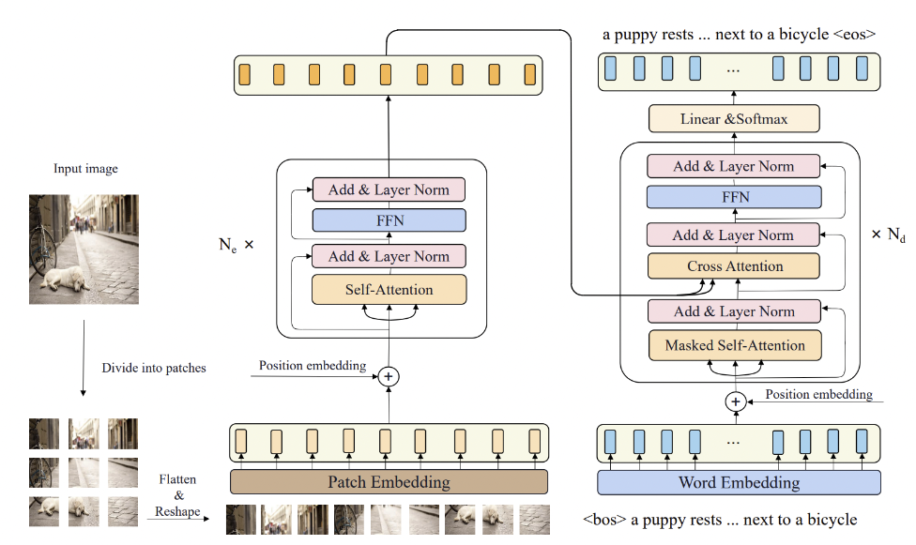
Approach
Davidson, Pagidi, Dave

Slide 4
Results
Present results
Describe dataset
Graphs, plots, performance measures used
Davidson, Pagidi, Dave

Slide 5
Conclusion
Takeaways
Achievements
Future Work
Davidson, Pagidi, Dave

